Slide 1


MOT 131A Emerging and Breakthrough Technologies
Prof. dr. J. Roland Ortt
Notes:
Personal introduction
Let me introduce myself by sharing a few things of my background that have a relationship with this course
In 1990 I just finished my studies in economy. Back then I was interested in empirical quantitative research, using large datasets (using surveys) and statistical analysis.
In marketing there was a renowned professor that was teaching about quantitave modelling. I joined his work and started to do research for him. Of course I also learned more conceptual things. I learned that innovation process involves an (innovation) project, and if completed well, diffusion would be large. That idea, misconception widely helt, will return in this course.
I was granted a PhD-position in Delft at IO. Topic: who wants a video-telephone? My perspective: this is a market research project (a survey) to find out potential customers of a radically new technological innovation. One issue we didn’t know at that time what the potential applications were. So, I designed a questionnaire to find out. My mentor, a psychologist, blocked my first questionnaire (because there was no theory or model behind it). I was pretty desperate (I thought that I was doing a great job). This was a disciplinary culture clash. The clash from from more quantitative empirical thinking rooted in the natural sciences toward social sciences, such as psychology or management sciences, where theory plays a bigger role.
Then I decided to study the history of several technological innovations in telecommunication and I found out that innovation diffusion went differently (then a project and then diffusion). That shaped my thinking and this course.
In the beginning of my PhD, I also studied the logic and structure of innovation projects. At that time, the mainstream Idea was a stage-gate project. Later on, different types of innovation projects emerged. In 1996 I started to work at KPN research and found out how innovation projects need to be adapted to the context. You will see the result in this course.
Later, after returning to academia I found out how technologies influence each other. The result of that will also appear in this course.

Slide 2
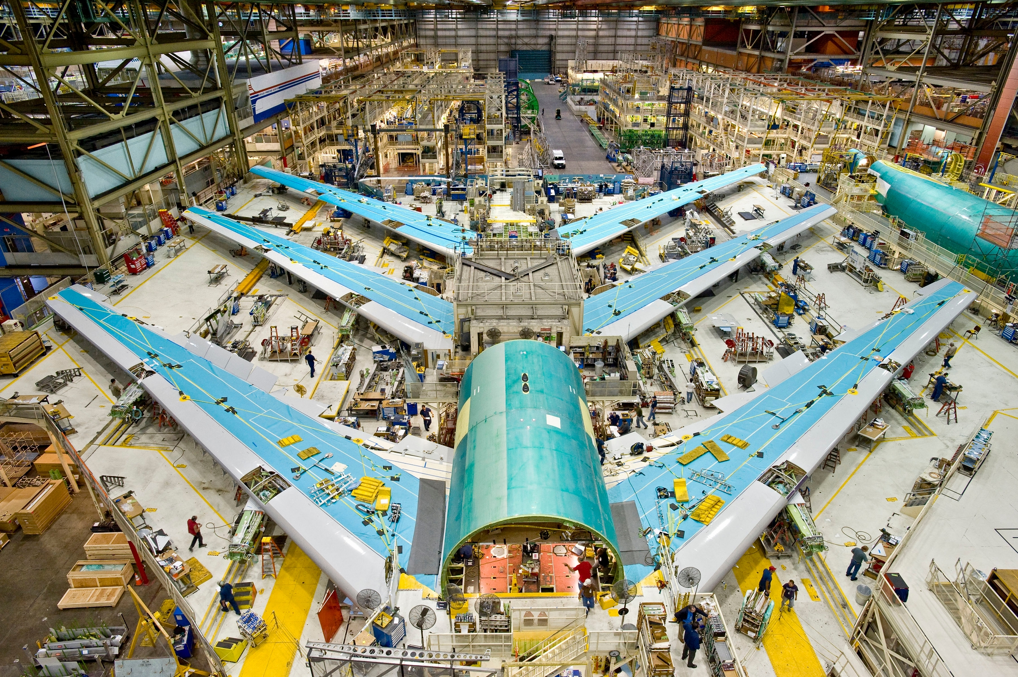
MOT 131A Contents Today
Introduction to the course
The topic of the course
Innovation processes on three levels
Learning goals
Schedule and practicalities
Innovation process as a project
Typical phases in a project
Notes:
Questions to the audience
Background bachelor?
Mechanical Engineering?
Industrial engineering?
Civil engineering
Chemistry (chemical engineering)
Electrical engineering
Aerospace
Physics
…
Current study? Most of you are MOT?
COSEM
EPA (PS Roos EPA en filosofie-student)
Double degree MOT?
Work experience
corporation (not just next to study but halftime or more)?
Involvement with innovation?
Start-up
Technological innovation (to be) introduced?

Slide 3
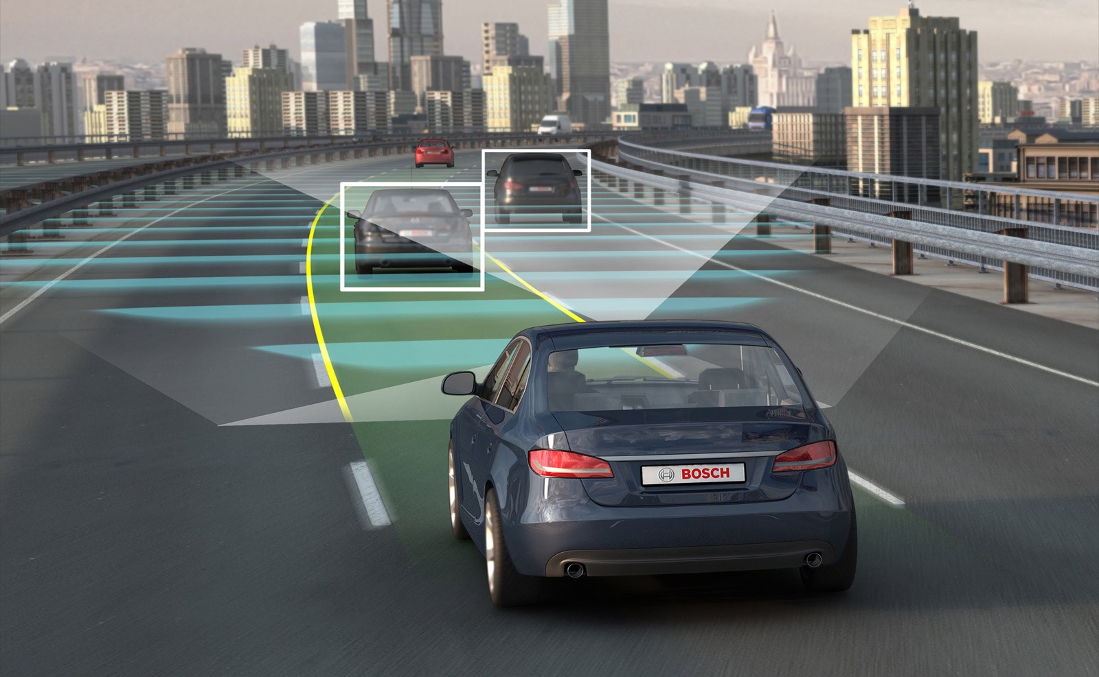

What is it?
How did this start, evolve?
What are relevant (f)actors?
What are the company strategies?

Slide 4
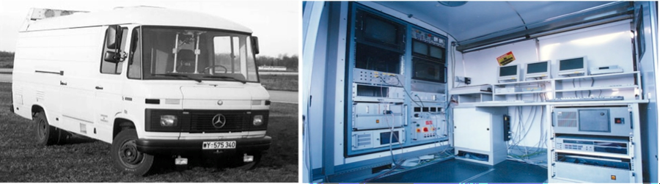
1980s Ernst Dickmanns and team at Bundeswehr University Munich
Topic of the course: emerging and breakthrough technologies.
Company perspective: at invention of technological product or system
What is it?
How will it evolve?
What are relevant (f)actors?
What are the company strategies?
1 Topic | 2 Levels | 3 Learning goals | 4 Schedule | 5 innovation project | 6 Project phases

Slide 5
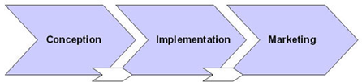
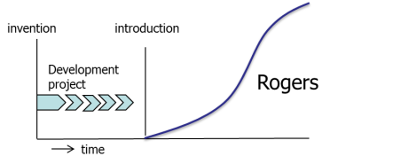
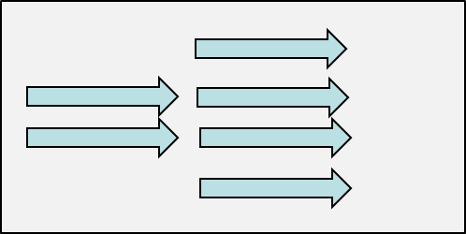
Focus MOT2421: Technological innovation process as a complex phenomenon
Many actors factors interact over time
at different levels of analysis
Levels | Questions | Scientific relevance; Managerial relevance
1. Project level: | Innovation project approaches? Fit of project in organization, market, innovation? | Innovation = product + …. Topics: History innovation projects Different project approaches Contextual view Application
2. Technology level: pattern of development/diffusion | What is the pattern? How does diffusion proceed? How does technology development proceed? What are (f)actors, mechanisms? What are company strategies? | Pattern = project + …. Topics: History patterns Different patterns (scientific) Actors, factors, strategies Application
3. Multi-technology level | How do different technology patterns emerge and influence each other? | Discipline = range of related new technologies (same principle) + What are other ways in which technologies relate to each other? Topics: Example of discipline How tech’s influence each other
1 Topic | 2 Levels | 3 Learning goals | 4 Schedule | 5 innovation project | 6 Project phases

Slide 6




Innovation process Innovation process Innovation process (level 1 : project) (level 2: technology) (level 3: multi-technology)
Mirjam Fuchs
MOT graduate
thesis project DSM
Wieger Aarts
MOT graduate
thesis project Philips
Nikoo Delgoshaie
MOT graduate
thesis project research internal
Thijs Jonckheere
MOT graduate
thesis project research internal
Problem:
Fuzzy front end of npd project takes too long is expensive and has uncertain outcome.
Solution:
Distinguish context variables that determine the type of npd process and design adapted process for each context.
Distinguish different types of projects
Problem:
Why does it take so long after the first market introduction of radically new high-tech products before large-scale diffusion starts?
Explanation:
Length of this process is assessed for multiple cases. For each case the variables slowing down the process are listed and combined.
Problem:
What is the effect on innovation process if technologies are combined?
Explanation:
High-tech products were chosen that represent a combination of products/technologies
1 Topic | 2 Levels | 3 Learning goals | 4 Schedule | 5 innovation project | 6 Project phases

Slide 7
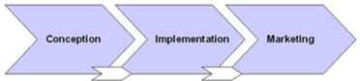
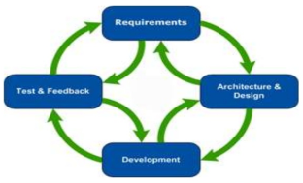
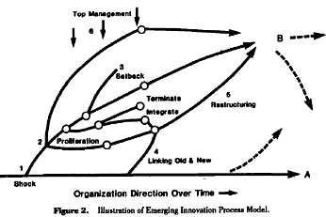
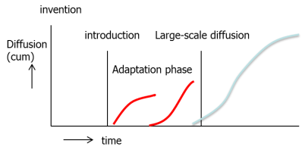


Three levels of innovation processes
Alternative models, theories on each level
Project (level 1) | Stage-gate | Agile-projects | Ad-hoc | -
Technology (level 2) | Innovation-diffusion paradigm | Pattern development and diffusion | Minnesota studies | -
Multi-technology (level 3) | Technology creation Genious inventor; Fertile R&D context; Combining techn’s. | Technologies in a discipline | Competitive technologies | Complementary technologies
1 Topic | 2 Case | 3 Levels | 4 Learning goals | 5 Schedule | 6 npd-process
1 Topic | 2 Levels | 3 Learning goals | 4 Schedule | 5 innovation project | 6 Project phases

Slide 8
Learning goals for the entire course (1)
Learning goals: After the course you should be able to …
Explain that innovation processes represent a complex multi-level phenomenon.
Describe why studying innovation on multiple levels of analysis is important.
Describe different types of innovation processes (project-level).
Describe why an innovation is more than a new product.
Describe several types of innovation projects.
Describe how the ideas about innovation projects evolved in time.
Relate the innovation process to organizational structures, market characteristics and
types of products, for example, and be able to propose specific processes in a situation.
Distinguish patterns of development and diffusion of breakthrough technologies (technology-level).
Describe why pattern is more than a project + diffusion.
Describe how theories about technological progress evolved over time.
Describe phases that can be combined into different patterns.
Describe different actors, factors and mechanisms (long/short phases).
Describe company strategies during the pattern.
1 Topic | 2 Levels | 3 Learning goals | 4 Schedule | 5 innovation project | 6 Project phases
Notes:
Perspective
Innovation is considered as a multi-level phenomenon:
Project-level (project within an organization or network of organizations)
Market-level (development projects of multiple actors and diffusion over time (typically decades) in society).
(maybe separate learning goal on multi-level phenomenon of innovation?)
Relevance for you to attain these goals
All engineers will be involved in innovation processes, most of them will become project leader. Once a project goal is formulated (a new product should be developed) then a process has to be designed.
The speed of development and diffusion is always predicted, mostly underestimated, sometimes over-estimated. Most predictions are either overly optimistic or pessimistic. Knowledge of the patterns, factors and mechanisms are a way to master the dynamics of development. As a result, ungrounded predictions are critically discussed and, more important, strategies to cope with the dynamics in the patterns can be distinguished.

Slide 9
Learning goals for the entire course (2)
Learning goals: After the course you should be able to …
Describe different types of innovation processes (multi-technology-level).
Describe why an invention is more than a new technology.
Describe how a discipline emerges and evolves (with an example).
Describe how technologies can influence each other in other ways.
Competition and substitution between products/technologies.
Complementarity between technologies
…
Describe how the system of three levels can be used to make sense of
Increasing speed of technological innovation.
Effect of digitization on innovation.
Competition
1 Topic | 2 Levels | 3 Learning goals | 4 Schedule | 5 innovation project | 6 Project phases

Slide 10
N | Date | Time | Place | Topic
 | 04-09 Mo | No lecture
1 | 08-09 Fr | 08.45-11.30 | Aula hall C | Introduction; Innovation projects (part 1)
2 | 11-09 Mo | 13.45-16.30 | Aula hall C | Innovation projects (part 2);
3 | 15-09 Fr | 08.45-12.30 | TPM-A | Innovation projects (part 3); Guest lecture (Vladimir Sobota) Assignment 1
4 | 18-09 Mo | 13.45-16.30 | Aula hall C | Pattern of development and diffusion
5 | 22-09 Fr | 08.45-11.30 | TPM-A | Actors and factors during the pattern
 | 25-09 Mo | No lecture
6 | 29-09 Fr | 08.45-11.30 | TPM-A | Hype cycle; Technology development
7 | 02-10 Mo | 13.45-16.30 | Aula hall C | Strategies during the pattern (1)
8 | 06-10 Fr | 08.45-12.30 | TPM-A | Guest lecture (Barbara van Veen); Assignment 2
9 | 09-10 Mo | 13.45-16.30 | Aula hall C | Strategies during the pattern (2)
10 | 13-10 Fr | 08.45-11.30 | TBM-A | Development of a discipline; Interaction between technologies
11 | 16-10 Mo | 13.45-16.30 | Aula hall C | Development of a discipline; Guest lecture (Barbara van Veen)
12 | 20-10 Fr | 08.45-11.30 | Flux hall B | Innovation processes on different levels; Guest lecture (Lassi Tiihonen)
 | 06-11 Mo | 13.30-16.30 | Flux hall A and B | Exam
 | 22-01 Mo | 13.30-16.30 | 3Me hall H and I | Re-take
Schedule
1 Topic | 2 Levels | 3 Learning goals | 4 Schedule | 5 innovation project | 6 Project phases
Notes:
Tentaive guest lecture
Rinse: international differences, diffusion within a corporation
Guest lecture on the role of pilots

Slide 11
2 or 3 in class assignments
Schedule
Form group of 5 people
Assignment
Will be introduced first in lecture
You work on it for an hour
We discuss the first ideas in lecture
Then you hand in assignment later on the same day
See schedule for dates
Literature, Exam & Grading
Literature: Slides and several articles (Brightspace)
Grading: Exam (80%) and Assignment (20%)
1 Topic | 2 Levels | 3 Learning goals | 4 Schedule | 5 innovation project | 6 Project phases

Slide 12
MOT 2421 Introduction
After a short break
we will start again at …..

Slide 13
MOT 2421 Contents Today
Introduction to the course
The topic of the course
Innovation processes on three levels
Learning goals
Schedule and practicalities
Innovation process as a project
Typical phases in a project

Slide 14
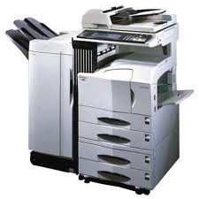
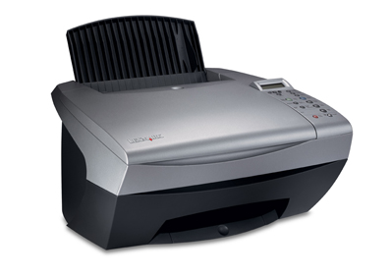
1 Topic | 2 Levels | 3 Learning goals | 4 Schedule | 5 innovation project | 6 Project phases

Slide 15
Innovation is more than a new product (a)
Project-level aspects of the innovation process
Xerox copier: a complex innovation
Product innovation:
Product (physical): Very complex product for high volume high quality copies
Distribution: Personal sales
Price: Lease model for machine + variable price per copy
Communication: a top product for the high-end niche of organizations
Compl prod & services: Special paper, dedicated sales and service personal
Process innovation: Completely dedicated production line and dedicated complementary prod/services
Organization: Big personal sales unit and big R&D unit
Supply chain consequences Xerox manages it all (with some suppliers)
1 Topic | 2 Levels | 3 Learning goals | 4 Schedule | 5 innovation project | 6 Project phases
Notes:
Two companies, Xerox and Canon, in the same market (copying) with completely different business models
This case will be discussed later on, again, when we describe the innovators dilemma (market mechanisms in innovation processes) and again somewhat later when we discuss strategies of companies over the TLC.
15

Slide 16
Innovation is more than a new product (b)
Project-level aspects of the innovation process
Canon copier: a simple innovation
Product innovation:
Product (physical): simpler product less parts (less volume, less speed)
Distribution: retail
Price: lower price
Communication: a simple product that everybody can use
Compl prod&services: self-repair
Process innovation: re-design of product, production, distribution and service
Organizational innovation: personal sales unit is no longer needed, R&D has different role
Supply chain innovation Changes in the network of companies
1 Topic | 2 Levels | 3 Learning goals | 4 Schedule | 5 innovation project | 6 Project phases
Notes:
Why has Xerox problems with Canon as a competitor?
Even when it could develop the same product (design/develop capability is available at Xerox, it holds all patents). Development would probably more expensive already (high-educated top developers).
Even when that is introduced at the same time. Although Xerox obviously did not envision this simple-copier market at the same time.
Even when they could start another brand. So they would not suffer from an image problem (Bentley does not sell simple cars)
Why did Xerox not introduce copiers in the mass market?
Xerox has a large overhead because of the amount of R&D (aiming and revolutionary new technologies) and has a huge sales & service organization because of their lease model and acompanying personal sales approach. Canon has entirely different type of R&D, aiming at making copiers that are more easy to produce and to service (R&D close to production) and they use retailers and therefore lack the large sales organization. Canon and Xerox have a different organization structures and culture and work processes. (the relationship org structure and work process can also be discussed in the R&D generations story illustrating how different visions on innovation process lead to different structures of the R&D function)
Why can Xerox not remain in the top-segment?
Canon has a simpler product but because of the huge sales sales volume can propably develop products quicker and thereby attack Xerox from below.(see als Christensens innovators dilemma)
16

Slide 17
Observations from the case 1. Xerox Canon machines were fundamentally different 2. Xerox and Canon have fundamentally different marketing mixes, compl prod/services, production facilities and organizations. And client groups are fundamentally different. 3. Xerox created the market, Canon made it a mass market (both entered in different phases of the pattern)
Project-level aspects of the innovation process
Innovation is more than a new product (c)
Messages from this case 1. Innovation = product as part of consistent marketing mix (link high-tech marketing) 2. Innovation as a consistent marketing mix needs to fit into the type of organization (requires a particular type of organization). 3. Innovation as a consistent marketing mix needs to fit into the type of organization and larger network (supply chain and market context (requires a particular type of organization) and needs to fit with the type of customers (which to some extent depend on the phase in the pattern of development and diffusion)
Innovation = consistent marketing mix fitting in organization, fitting in customer groups and accordingly fitting in stage of the market
1 Topic | 2 Levels | 3 Learning goals | 4 Schedule | 5 innovation project | 6 Project phases
Notes:
This slide needs to be simplified in line with earlier slides and next lecture
Discuss implications
of the fact that a particular innovation seems to fit in a particular type of organization (only)
The organization can hamper the development and implementation of innovation because of its supply chain (position in a network of companies), organizational structure and other characteristics. Core competences become core rigidities (Leonard-Barton (1988) (example: Kodak invents digital photography but goes bankrupt because it cannot implement its own invention in the organization and introduce an innovation).
In terms of flexibility (much lower than expected!) of an organization to commercialize a particular innovation (for which it owns patent and masters the technological aspects).
17

Slide 18
Message (innovation = ) | Consequence
Product + service Marketing-mix Organization Network of companies Ecosystem (customers ..) | Good product is not enough for success Innovation can require a fundamental system change for the entire organization and network around it. Innovation that fits system is easier than one that requires new/changed system. Innovation with new system is easier than innovation that needs to rebuild existing system. Incumbent company problem Start-up company problem
1 Topic | 2 Levels | 3 Learning goals | 4 Schedule | 5 innovation project | 6 Project phases

Slide 19
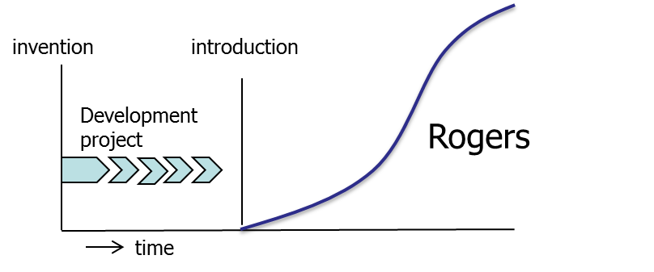
Project aspects of the innovation process
Typical phases in the process (a)
Idea generation, testing and selection
Concept generation, testing and selection
Product development, testing and improvement
Production development
Marketing development
Market introduction
Anything missing?
You have to innovate
Innovation is a project, after that you can introduce the innovation
1 Topic | 2 Levels | 3 Learning goals | 4 Schedule | 5 innovation project | 6 Project phases
Notes:
Open question:
What are the phases of an npd process?
Build up this process in discussion with the group and discuss the activities in each phase.
Lessons
First phase, strategic phase, is often omitted
Last phase, life cycle management, is often omitted.
Parts in d.e.f. can be scheduled in parallel
Relations between product/production development and marketing plan
Product modular - Production process in batches to make these modules (market-driven numbers) and separate assembling - Marketing (on demand production/ assembling via internet or other channel)
Standard product - Production process standard (economies of scale) – Marketing via retail or other channel
Complicated product with service repair requirements and learning – Production process standard (economies of scale) – Marketing via shop/experts and so on.
Examples
The more unique the product the more production is affected.
Parallel activities require some proper design of a concept
The logic combination of the type of product, type of production and type of marketing, should be formulated already in the concept stage. If this is not done well, the three parallel processes (or the three sequential processes) will continue to affect each other and thereby a chaotic process of constant iterations will emerge. (compare this with thesis process)

Slide 20
Project aspects of the innovation process
Typical phases in the process (b)
Strategic phase (to innovate or not)
Idea generation, testing and selection
Concept generation, testing and selection
Product development, testing and improvement
Production development
Marketing development
Market introduction
Life cycle management
Innovation is a strategic choice
Innovation can be organized as a project, after introduction many projects can follow
1 Topic | 2 Levels | 3 Learning goals | 4 Schedule | 5 innovation project | 6 Project phases
Notes:
So what are the ways to generate ideas (step b in the process)
Consumer research
Problems with existing products investigated in different ways
Focus groups with customers
Interviews customers
Surveys among customers
Observation studies (make video how customers use your product)
Look at reviews in social media about your product
Check the requests for repair and maintenance: they may indicate problems in the product
Brainstorm
Business intelligence: look at products ideas from competitors or actors in related markets
Other options

Slide 21
Project aspects of the innovation process
Typical phases in the process (c)
Learning points regarding the NPD-process
In each stage multiple alternatives are created and a limited number of alternatives is selected. The number of alternatives typically decreases over the npd-process. (innovating by creating many alternatives and then selecting)
Stage-gate: go/no-go at each stage. (innovating by having the selected alternatives evaluated)
Market and technology input throughout the process (innovating by considering information during the process)
Typical stages: idea/concept and product creation/selection Stages typically forgotten:
Up front: decision to innovate
End: life cycle management
1 Topic | 2 Levels | 3 Learning goals | 4 Schedule | 5 innovation project | 6 Project phases
Notes:
Why is the upfront decision to innovate so important?
Because there are alternative strategies next to new product development (lecture 3)
Because this decision is crucial in more political or sensitive type of contexts of type of innovations. Especially when multiple stakeholders are involved each with theuir own interests and perspectives.
Why is the life cycle management phase so important?
Especially (as will be discussed in lectures on the pattern of development and diffusion, level 2) in the phase 2 (the adaptation phase), designing for adaptability is important, this may be different in phase 3 (stabilization phase).
Products, production and marketing are designed differently (for the first time) if you know that the product will change over the life cycle.

Slide 22
Project aspects of the innovation process
Typical phases in the process (d)
Market technology information
Market technology information
Market technology information
Market technology information
Product develop-ment
Market technology information
Market technology information
Market technology information
Idea generation selection
Concept generation selection
Production process developm
Strategic phase
Pilot
Intro-duction
Life cycle
Marketing plan
developm
Go/no-go
Go/no-go
Go/no-go
Go/no-go
Go/no-go
Go/no-go
Go/no-go
1 Topic | 2 Levels | 3 Learning goals | 4 Schedule | 5 innovation project | 6 Project phases
Notes:
Why strategic phase? To compare and choose between strategic alternatives!
What does idea involve? Not just a product but also ideas about the user group, the usage
context, the technology, the production process, the marketing
plan (business model), life cycle management.
What does concept mean? Visualization, simulation or paper and pencil version of the
product in usage context with users.
Why product, production and marketing in parallel?
Because of their intimate relationship. Example: modular product!
Why life cycle? Implementation often means a handover and that is a source of
problems. Later improvements require the samen expertise used
during original development (example: dissolving knowledge for products introduced will pose a
serious problem afterwards: military radar systems) .
Why go-no go? Process otherwise never stops
(project teams have a tendency to go on always)
Management involvement is important
Technical feasability and market potential need to be checked
through the entire process.
(example: size of the potential market as criterium for medicine
development)
Why market/technology info throughout the process?
To assess viability early on in the process! To involve customers
and other stakeholers and technical aspects throughout the process.
(large system development: some problems are ignored untill the
end of the project and then, too late tend to block the entire effort)

Slide 23
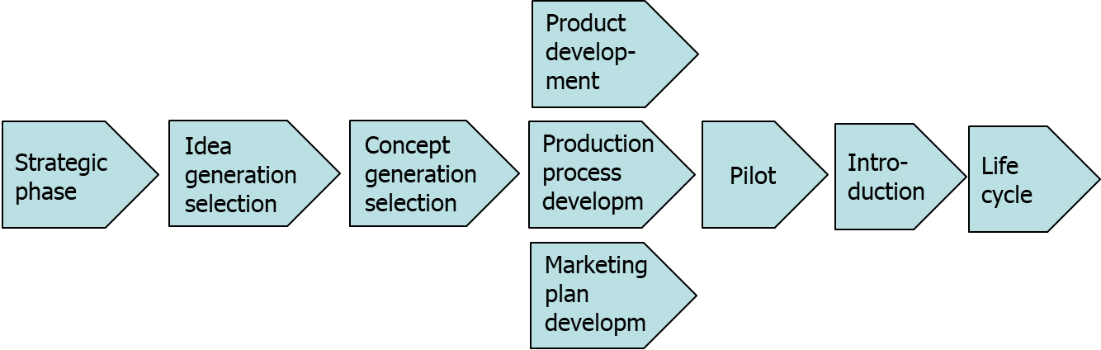
Project aspects of the innovation process
Typical phases in the process (e)
Why are some activities completed in parallel?
Because they only can be completed in combination.
Since they are interrelated.
Why are iterations needed?
Because there is uncertainty (there is no upfront and exact definition of the innovation that will be developed).
In the earlier stages many alternatives are considered and choice are made, and sometimes in turns out that a choice was wrong, so the process needs to be reiterated.
In parallel stages, the activities are so much dependent and unknown.
1 Topic | 2 Levels | 3 Learning goals | 4 Schedule | 5 innovation project | 6 Project phases
Notes:
Why are the three elements in the middle scheduled in parallel?
Because they need the same input from the previous phase
Because they can be in parallel and then development goes faster.
Because these three things are so much inter-related that they cannot be scheduled in sequence (without starting an endless loop).
PS this loop is also a way to structure an innovation project (Scrum/agile) but then you have to develop per module.. Later on discuss three ways ways to deal with modular products
Stage-gate with three phases in parallel (if you know the concept with all modules up-front)
SCRUM with mutiple iterations, when you do not know all modules up-front but know a starting list with priority and thus can start.
Platform-development.

Slide 24
Learning goals
After today you should be able to explain .…
Innovation processes evolve on multiple levels simultaneously
Examples of innovation processes on three levels: project, technology and multi-technology level.
That an innovation is more than a new product alone, each product innovation is part of a larger mix of aspects.
What possible consequences are of this mix of aspects around an innovation.
Typical phases of an innovation project and which ones are often forgotten.
Why phases are scheduled in parallel/sequential and why iterations are required.

Slide 25
Next lecture: innovation projects (part 2)
(Monday 11st of September 2023)
Study material
Article: Cooper (1990) article on the stage-gate process
Article: Szalvay (2004) on agile software development
Article: Different approaches to cope with the same trends
Article: The evolution of innovation management over time
Article: Contextual Innovation Management

Slide 26

Questions?

Slide 28
MOT 2421 Introduction
After a short break
we will start again at ….

